Slide 1
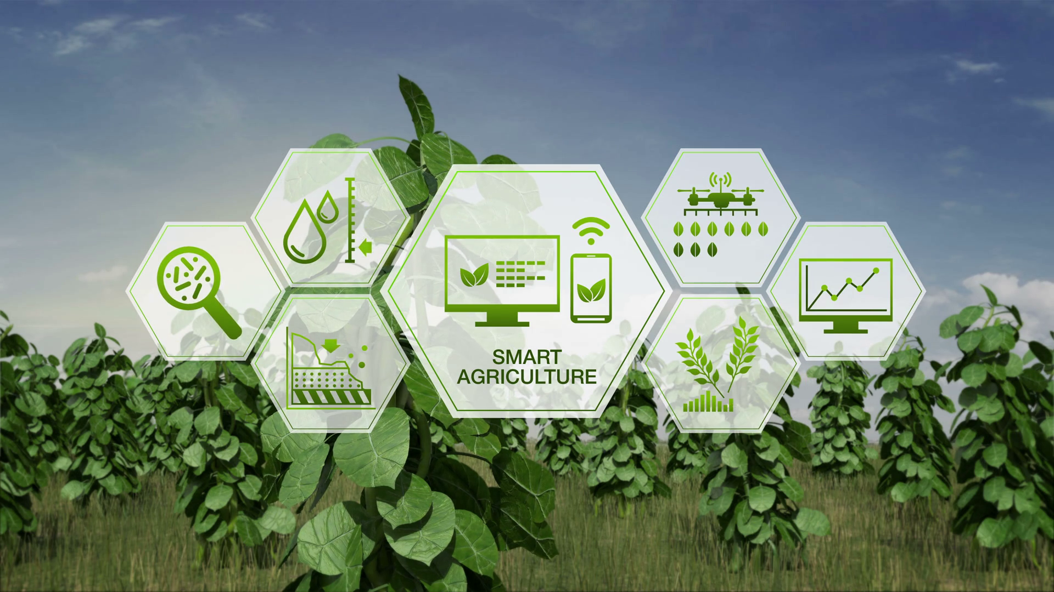
AAGS- lets green IT!
AAGS
Lets Green IT

Slide 2
Introduction- AAGS
India is a country of farmers and orchards.
Indian agriculture sector accounts for 18 per cent of India's GDP and provides employment to 50% of the country’s workforce.
India is the world’s largest producer of pulses, rice, wheat, spices and spice products.
India is an agriculture based country, where more than 50% of population is dependent on agriculture. This structures the main source of income.
It is said that agriculture in India is a backbone for Indian Economy.

Slide 3
With digital India schemes and ease of access of internet even in rural areas, internet has become a common luxury.
Yet, Indian farmers are left behind in this modern era of internet.
We at AAGS strive to change this.
Our vision is to digitalise and modernize this industry by making the jobs of the farmers easier and providing such solutions at economical rates. Our motive is to strive to bring about a new green revolution in the Indian Argo industry using IT.

Slide 4
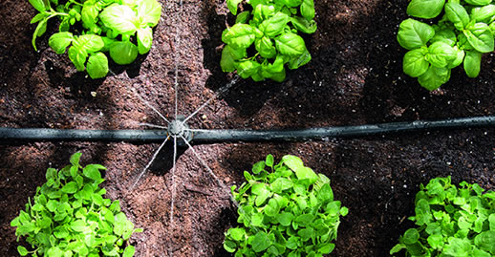
Some of the features included in our current prototype include:
Dynamic Watering.
Some benefits of us watering crops dynamically:
Minimizing crop water stress to maximize yields.
Reducing the cost of water and labor through fewer irrigations, making maximum use of soil moisture storage
Lowering fertilizer costs by holding surface runoff and deep percolation (leaching) to a minimum
Increasing net returns by increasing crop yields and crop quality
Minimizing water-logging problems by reducing drainage requirements
Assisting in controlling root zone salinity problems through controlled leaching

Slide 5
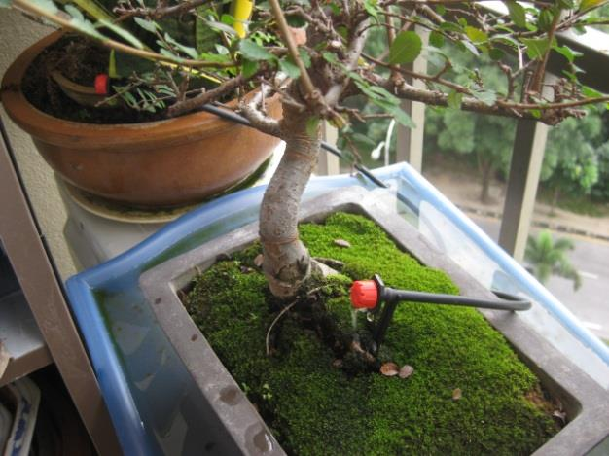
2) Automated Pesticide.
The advantages of automatic pesticide application
systems are:
-) No exposure of the operator to toxic materials
-) Increased efficiency and effectiveness
-) Optimal timing
-) Reduced error by the operator. Reduced pesticide dosages make them of increasing importance in modern agriculture due to health issues caused by excess pesticide usage

Slide 6
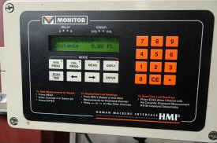
3) Silo Monitor
A silo is a structure for storing bulk materials. Silos are used in agriculture to store grain or fermented feed known as silage. Silos are more commonly used for bulk storage of grain, coal, cement, carbon black, woodchips, food products and sawdust.
Keeping track of how much stock is left automatically is much easier than going and noting down the values or counting them manually if you forget the previous readings. This is why a silo monitor will be an additional helping tool to the farmers through our application.

Slide 7
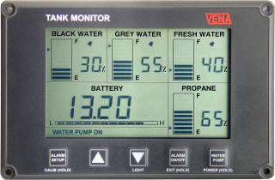
4) Water Tank Monitor.
Similar to our silo monitor, this will inform the farmer about how much water is available and if any abnormally is noticed, the farmer can easily take the necessary action. This would be impossible without a water tank monitor.

Slide 8
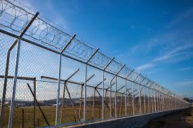
5) Electric Fence Control.
An electric fence is based on a strong psychological barrier coupled with a weak physical barrier that keeps wildlife or farm animals in and unwanted animals and vermin.
Electric Fences offers the following benefits:
→Low cost. →Easy to build. →Durability. →Flexibility. →Low maintenance. →Less stock damage.

Slide 9
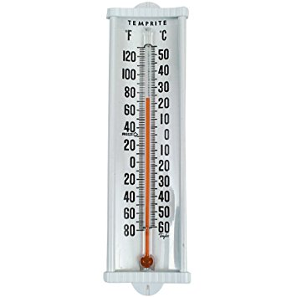
6) Humidity and Temperature.
Knowing about the temperature and humidity of the farm will help the farmer estimate which crop to plant and when to plant it.
It’s not necessary that a seasonal crop can be planted any time in the season for the best produce. Knowing about these details will help decide a major influencing factor.

Slide 10
7) Suggestions of Which Crop to Plant and When and in What Quantities.
You know what’s the biggest factor which influences one farmer’s crops to be better than the others?
Knowledge!
Due to illiteracy, many farmers follow the old traditional methods and techniques for farming which may not actually be the best choice for a successful harvest..
Technology has always been helping farmers.. For example: Tractors helped make sowing seeds easier.. This time, technology is going to help a farmer by telling him what’s the best thing he can do to get the best harvest possible taking into account several factors like temperature, terrain and water quantity available..

Slide 11
Our Future plans
Being freshers with insufficient knowledge about machine learning, we could not implement our idea of suggesting which crop to plant, when and how to do it to the farmer. We look forward to learning machine learning and related algorithms and develop on our idea.

Slide 12
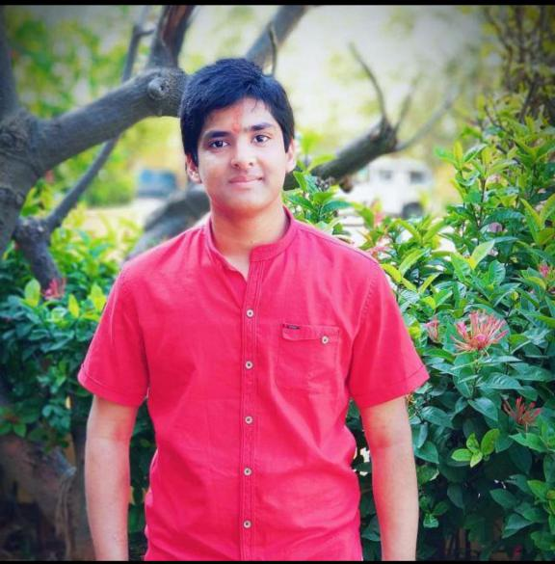
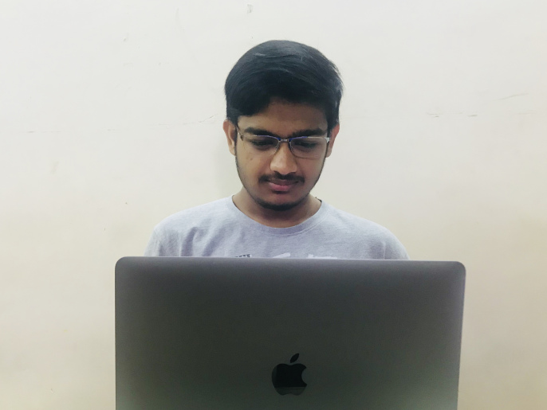

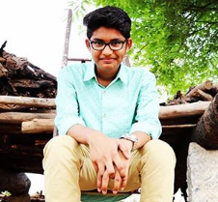
Meet the team
Akshat Gupta
Arpit Jain
Gauransh Arora
Sai Sandeep

Slide 13
Contact Us
Company Name: AAGS
Product Name: Lets Green IT
Email: letsgreenit123@gmail.com
Phone: +919600093179
Location: Vellore Institute of Technology, Vellore- 632014. Tamil Nadu, India.

